Slide 1
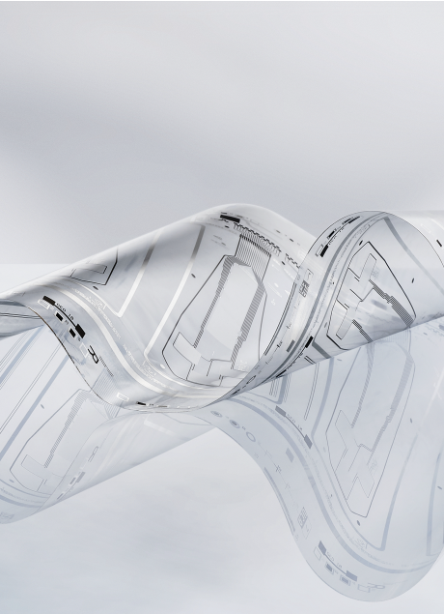
Introduction to the OE-A Advancing the flexible and printed electronics industry
OE-A
VDMA e.V.
Frankfurt, Germany
www.oe-a.org
info@oe-a.org
Image source: Poly IC

Slide 2
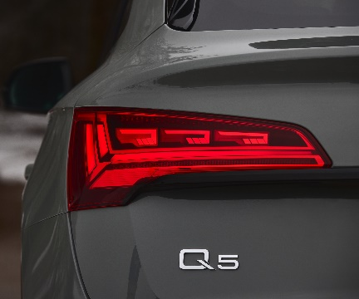

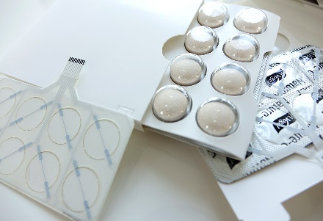
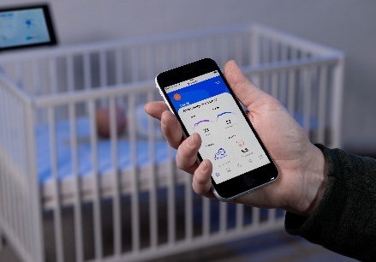
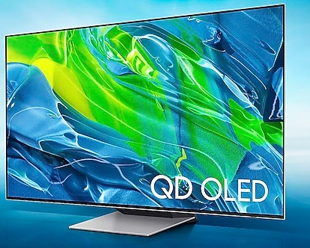
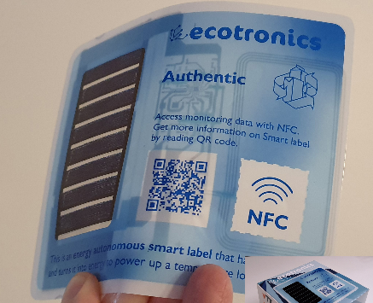



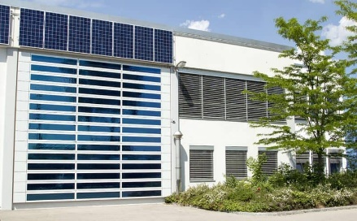
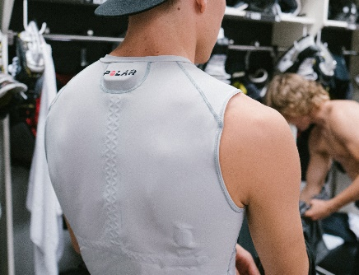
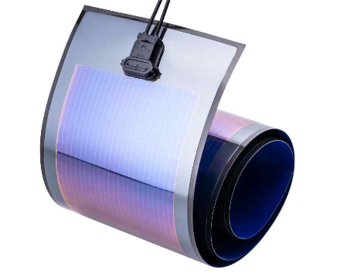
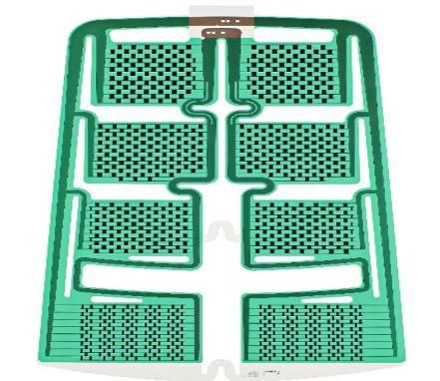

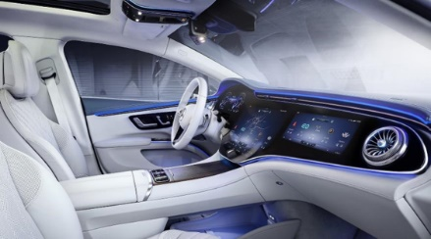
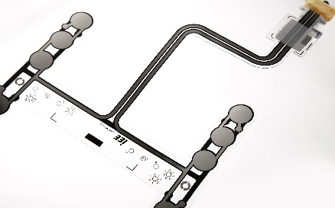
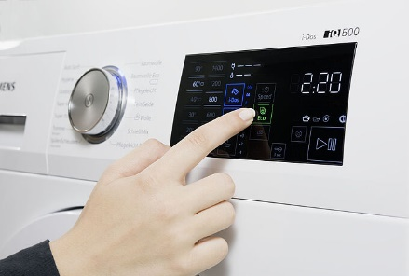
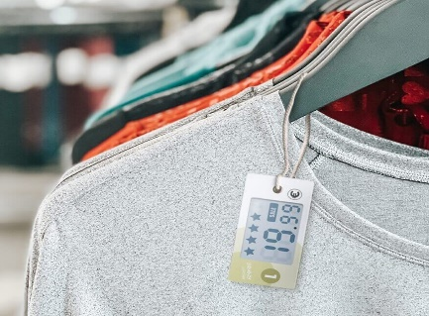
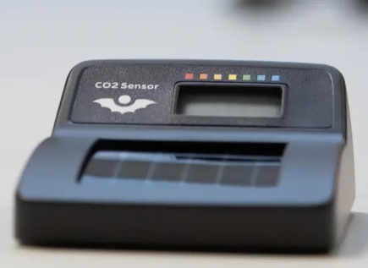
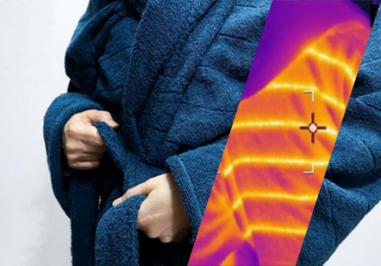
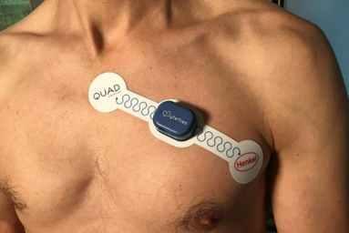
Flexible and Printed Electronics in Everyday Life
Image Source: E-Ink, Audi, Mercedes, IEE, Samsung, VTT, Ynvisible, Henkel, Metafas, Heliatek, Dracula, Holst Center, CeNTI, Polar
Automotive
Consumer Electronics
Smart Packaging
Smart Building
Healthcare and Wellness
Electronic Ink
OLED
Smart Textiles
HMI
Heaters
Sensors
White Goods
NFC-Tag / IoT
OPV
Heaters
Health Patch
Indoor Sensors

Slide 3
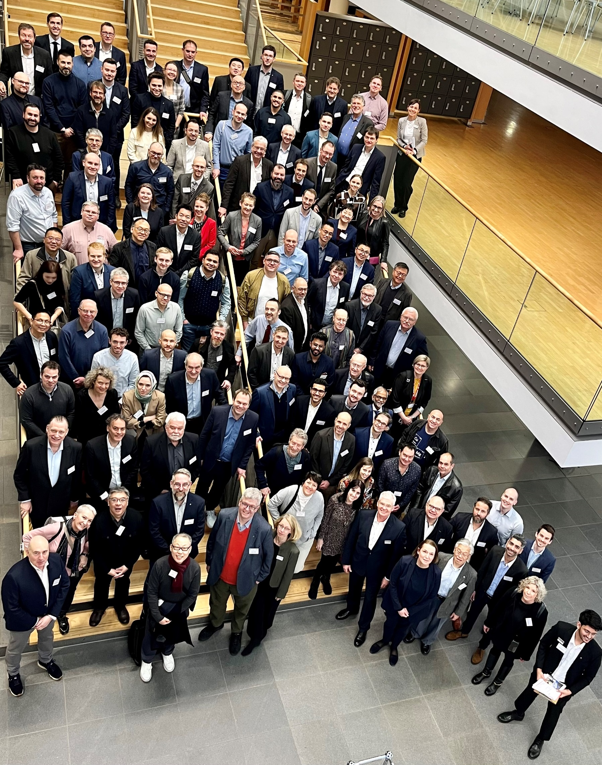
OE-A - Overview
The largest industry association for flexible and printed electronics, driven by around 180 international members
OE-A is a working group within VDMA
Our members represent the entire value chain:
End-users
Producers & system integrators
Equipment & tool suppliers
Component & material suppliers
R&D institutes & universities
Image source: ojoimages4, Fotolia

Slide 4
OE-A - Advancing the flexible and printed electronics industry
OE-A connects you with companies and technology institutes throughout the entire value chain of flexible and printed electronics around the globe to grow your business and build markets.
As a global, member-led organization, we drive high-profile events, collaborative working groups, and strong advocacy empowering our members to lead innovation:
Gain market intelligence via technology & application roadmaps, strategic market information, industry forecasts, and business climate surveys.
Strengthen the expert knowledge of your teams and grow your staff into innovation leaders.
Increase global visibility at member meetings, LOPEC, and other international trade shows.
Collaborate in technical and non-technical working groups.
Engage in exchanges among experts, trainings, and web-seminars.
Benefit from advocacy, policy support, and partnerships with standardization bodies.

Slide 5


Benefits of OE-A Membership Networking, Information, Visibility & Market Entry Opportunities
Networking Opportunities
Web-Seminars
Frequent Working Group Meetings
Europe
North America
Asia
LOPEC
Industry Roadmaps
Demonstrator Projects
Standardization IEC TC 119
Industry Visibility
Advocacy (EC)
Products & Services Directory
Free subscription to ProFlextronics Journal
Biannual Business Climate Survey
Participation in international exhibitions / joint pavillions
Discounts on event tickets
Image source: Unsplash
oe-a.org/member-benefits

Slide 6
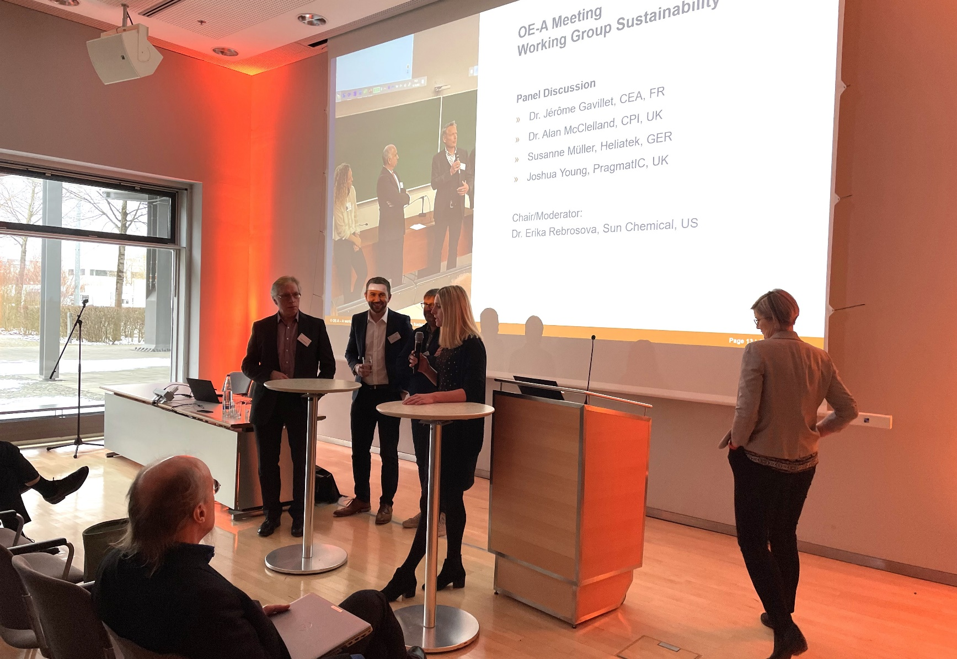
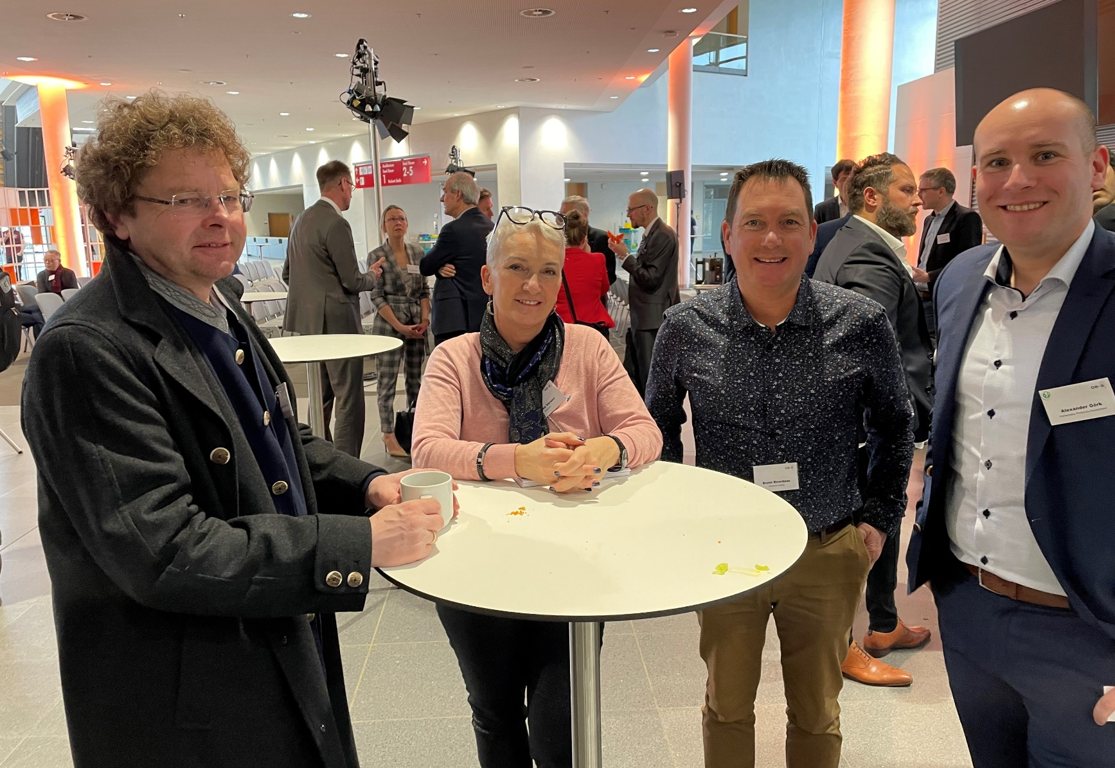
Our Working Groups
Encapsulation
Fuel Cells
Hybrid Systems
OE-A Competition
Education
Marketing
Sustainability
Women in PE
Image source: OE-A
November 16, 2020

Slide 7
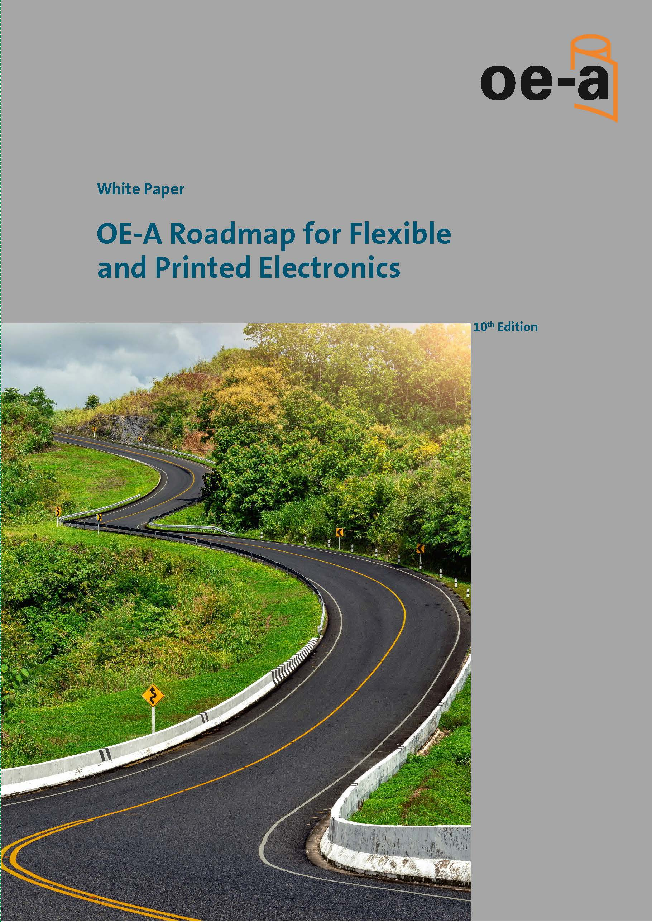
OE-A Roadmap White Paper
Why?
Support the strategic planning of the industry, academia, and politics
Who?
Based on the work of experts along the value chain
more than 100 experts in 24 teams
What?
Forecast for key industry sectors
Forecast for market entry of FPE Applications
Assessment of materials, processes, and technologies
What is NEW in the 10th Edition Roadmap?
“Sustainability & Green Electronics”
Defense and Aerospace, Robots, Fuel Cells, Standardization
Image source: OE-A
Interested in contributing? Contact: raswanth.sendhilsasikala@oe-a.org

Slide 8
New OE-A Roadmap Structure, 10th Edition
Industrial Themes
Industries:
- Automotive
- Consumer Electronics
- Healthcare
- Smart Packaging
- Smart Buildings
- Internet of Things
- Defense and Aerospace
Devices:
- Flexible & OLED Displays
- Electronics & Components (+ Fuel Cells)
- Integrated Smart Systems and
Hybrid Electronics Cluster
Enabling Technologies
Product Forecasts (current, short, medium and long term)
Key application areas
Key Application / Material / Technology Parameters
Key Challenges
Technology Levels
Technology Clusters:
- Functional Materials - Substrate Materials - Printing, Coating and Patterning Techniques - Assembly - Testing and Standardization
- Design and Simulation
Product Forecasts (current; short, medium, and long term)
Technology Readiness Levels
SWOT-Analysis
Key Technnology & Application Parameters
Key Challenges

Slide 9


Executive Summary vs. Whitepaper
Executive summary
8 pages of content
Free of charge
Digital copy only (Available for download)
QR CODE:
Whitepaper
> 310 pages of content
Digital copy only
Free for members
Now available in My.OE-A
For sale for non OE-A members
Available between April - May
Purchase at oe-a.org/roadmap
Image source: OE-A

Slide 10




Preliminary Event Schedule 2026/2027 Europe / Asia / North America
OE-A Meeting
February 23, 2026, Munich, DE One day before LOPEC
OE-A Free Student & Start-up Workshop: Printed Electronics
February 24, 2026, Munich, DE Organized by OE-A Working Group Education. Hosted by the Munich University of Applied Sciences
Welcome Reception sponsored by UDC at LOPEC 2026
February 25, 2025, 5:30-6.30pm, Munich (DE) Welcome reception for networking with NA LOPEC attendees, exhibitors
LOPEC 2026
February 24 - 26, 2026, Munich, DE International exhibition and conference for the printed electronics industry
VDMA European Summit 2026
March 12 - 13, 2025, Rome, IT Summit for the European machinery and equipment manufacturing industry
oe-a.org/events

Slide 11

Preliminary Event Schedule 2026/2027 Europe / Asia / North America
ICDT 2026
March 31 - April 3, 2026, Chongqing (CN) OE-A is partner of ICDT and organizes a joint technical session on flexible and printed electronics
OE-A Web-Seminar | Printed Electronics Insights: OE-A Competition 2026 - The Winners
April 16, 2026, online Presentation of the winning demonstrators of the OE-A Competition 2026
OE-A Meeting North America
June 11 - 12, 2026, Bay area, California (US) Networking dinner, on June 11 sponsored by Bayflex , company/institute visit (tbd) on the morning of June 12
OE-A Web-Seminar | OE-A Roadmap 10th Ed. :
June, tbd, online Presentation of the new Roadmap 10th Edition published at LOPEC 2026
oe-a.org/events

Slide 12

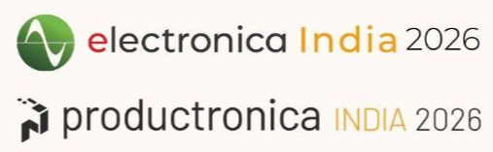
Preliminary Event Schedule 2026/2027 Europe / Asia / North America
ICFPE 2026
August 26 - 28, 2026, Jeju Island, (KR) OE-A is partner of ICFPE and organizes a conference session on flexible and printed electronics and a keynote by an OE-A member
OE-A Meeting Asia 2026 – delegation trip to India
September 14 - 18, 2026,
One week incl. company visits in Delhi, Pune, Bangalore regions and OE-A seminar at electronica/productronica India
electronica/productronica India 2026 - South
September 16 - 18, 2026, Bangalore (IN) OE-A Symposium: Flexible and printed electronics (part of the OE-A delegation trip India)
OE-A Power Lunch (online) – North America Edition, 2026
April 28 & September 2026, tbd
oe-a.org/events

Slide 13


Preliminary Event Schedule 2026/2027 Europe / Asia / North America
OE-A Meeting Europe 2026
October 13 – 14, 2026, Düsseldorf, DE
Hosted by Henkel
electronica 2026
November 10 - 13, 2026, Munich (DE) OE-A and LOPEC will host a two-day Printed Electronics Forum at electronica
Additional events and web-seminars will be added to the Event Schedule progressively.
oe-a.org/events

Slide 14
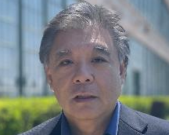
OE-A Board of Directors (2025 – 2029)
Chair
Vice-Chair
North America
Vice-Chair
Asia
Vice-Chair
Europe
Dr. Chloé Bois
ICI (CA)
Dr. Carsten L. Herzhoff Lohmann (DE)
Dr. Luke Pan Zhejiang Brilliant Optoelectronic (CN)
Dr. Alain Schumacher IEE (LU)
Eisuke Tsuyuzaki Bayflex (US)
Members of the Board
Pawel Czabak
LC Elektronik (PL)
Dr. Jérôme Gavillet
CEA Liten (FR)
Dr. Stijn Gillissen Henkel (DE)
Prof. Dr. Jukka Hast VTT (FI)
Thomas Kolbusch Coatema (DE)
Prof. Dr. Ulrich Moosheimer Hochschule München (DE)
Dr. Ofer Shochet Copprint (IL)
Prof. Dr. Jeroen van den Brand Holst Centre (NL)

Slide 15


































































180 Members Representing the entire value chain (1)
Companies
Equipment
Devices
Materials
End-User

Slide 16










































180 Members Representing the entire value chain (2)
Research Institutes

Slide 17

Global membership base
Europe 152
OE-A is active in
Europe
North America
Asia
Africa
VDMA / OE-A Headquarters
Frankfurt, Germany
VDMA Representations
Berlin, Brussels, Austria, BeNeLux, Italy, Poland, US, Japan, China, Brasil, India
North America 12
DE 65 FR 17
GB 12
NL 7
ES 7
FI 6
CH 5
AT 5
IT 4
CZ 4
LU 4
SE 4
PT 2
GR 2
PL 2
DK 2
BE 1
NO 1 RS 1
SI 1
Asia 12
CN 5
JP 3
IL 2
TW 1
IN 1
US 10 CA 2
Africa
ZA 2
Total: 178 Members (as of January 28, 2026)
oe-a.org/oe-a-members

Slide 18
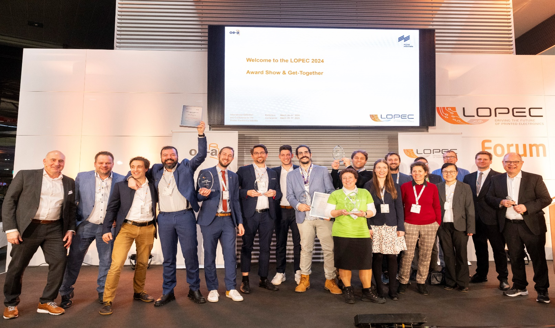
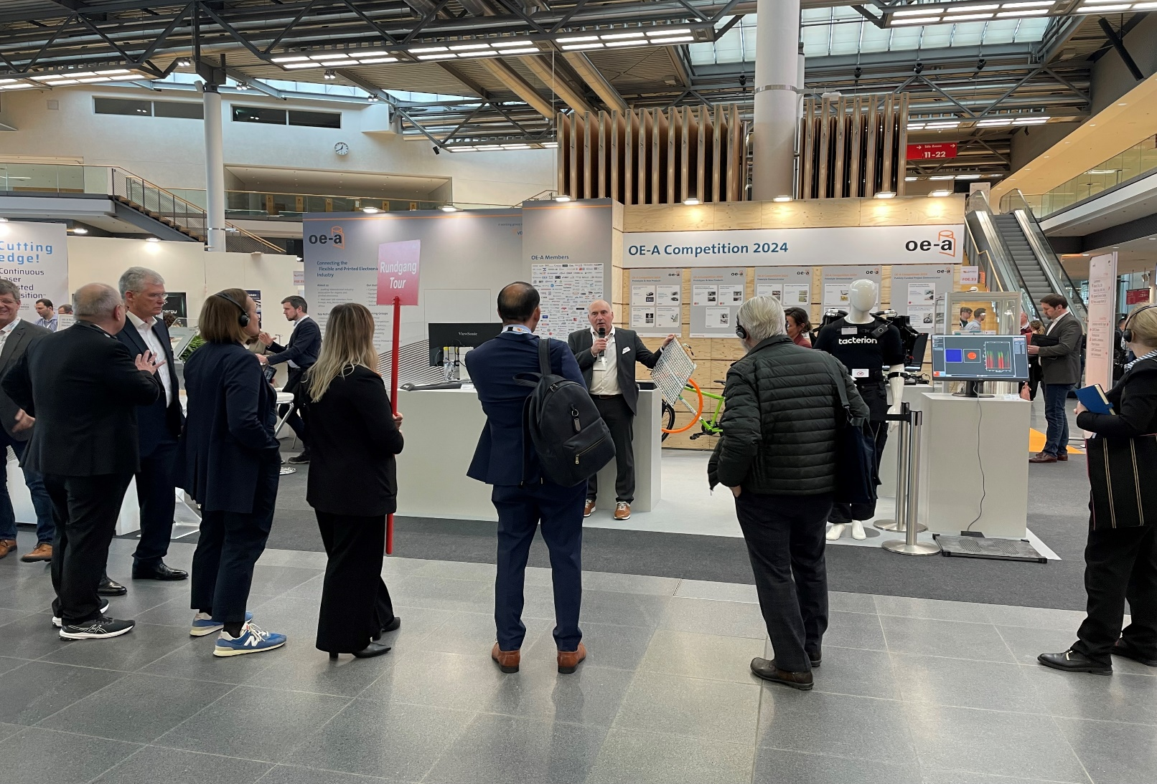

LOPEC 2027
March 02 - 04
ICM, Messe Munich
The central marketplace for Flexible, Organic and Printed Electronics, in cooperation with Messe Munich
2,500+ attendees
170+ international exhibitors
170+ presentations
Exhibition
Largest industry exhibition in the field
Start-up competition
Conference
Business, Technical, Scientific Conference
Pre-conference seminars
Call for Papers open August 11 – September 25, 2026
10% discount for OE-A members
Image source: Messe München
www.lopec.com
| info@oe-a.org

Slide 19
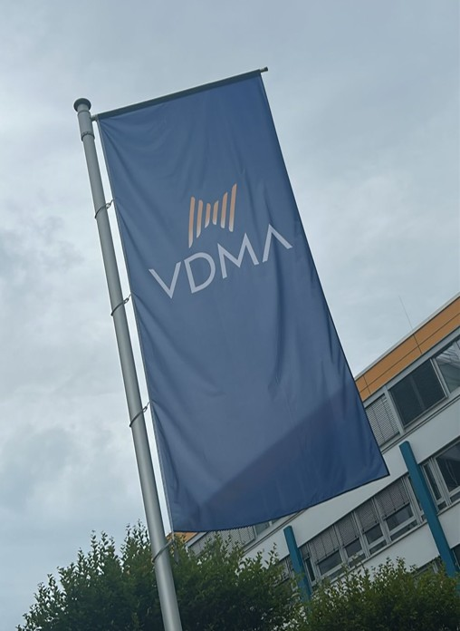

OE-A within VDMA Benefit from being part of something bigger
Update
Bild
Largest industry association in Europe (3,500 members)
35 trade associations - Experts for product-specific topics
11 specialized departments - Consultation in all specific topics
6 regional subsidiaries in Germany
Offices in Brussels and Berlin - Exchange with political decision makers and key stakeholders
Foreign subsidiaries in Brazil, China, India, Japan, US, Austria, BeNeLux, Italy, Poland, Singapore; On-site consultation and support
Working groups and forums - Cross-sectoral cooperation
Service companies (trade fair organizer, publishing house, insurance company etc.)
Image source: Hans-Peter Gauster / Unsplash
www.vdma.eu

Slide 20
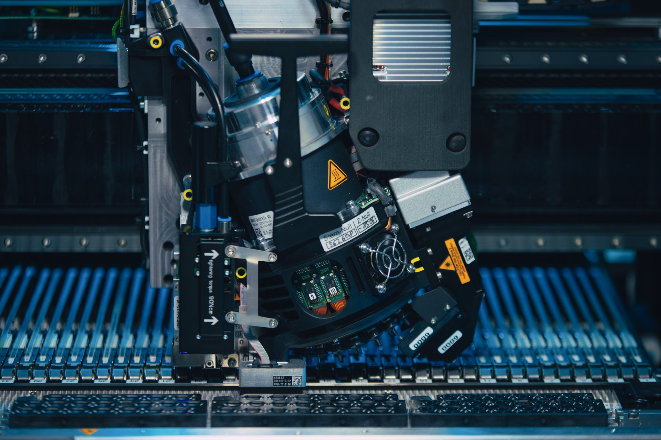
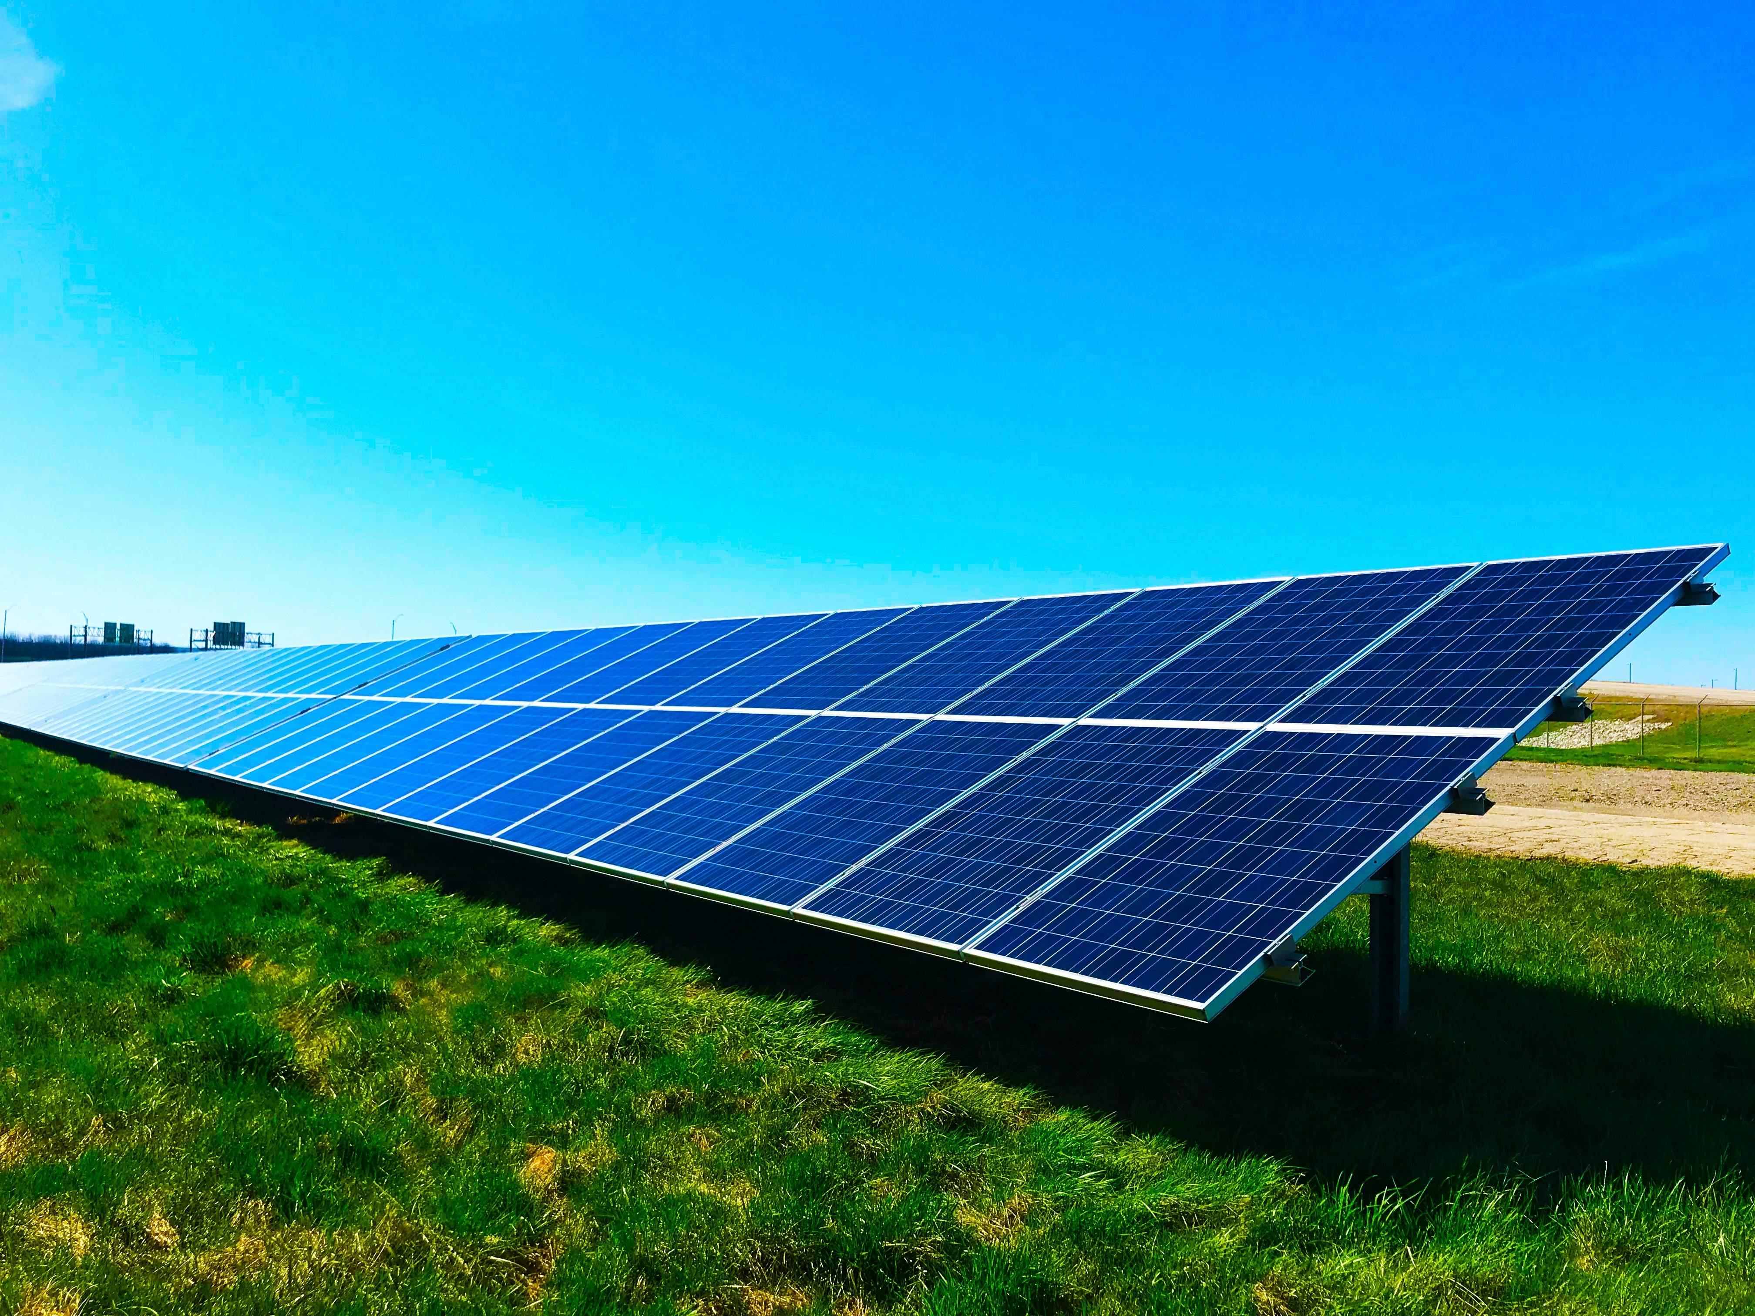
OE-A within VDMA: ESB
OE-A is an associated group within VDMA ESB (Electronics, Solar and Battery Production)
Three sector groups:
Productronic
Battery production
Photovoltaic-Production Equipment (PV)
Associated group:
OE-A
Joint activities:
OE-A Working Group Hybrid Systems
Productronica
PV
Image source: ASMPT, Foto von Chelsea auf Unsplash;

Slide 21
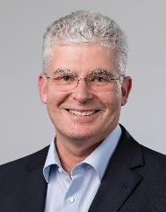
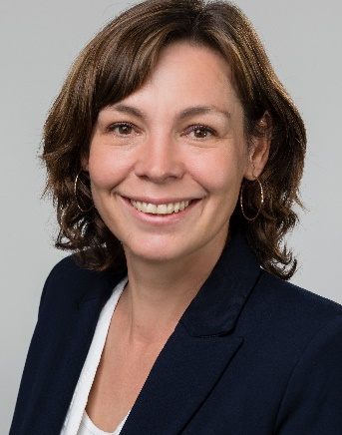
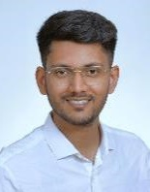
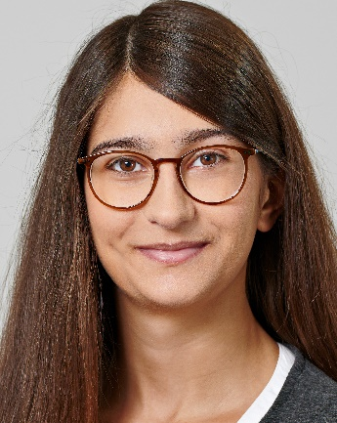
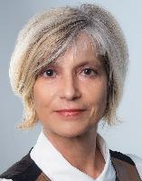
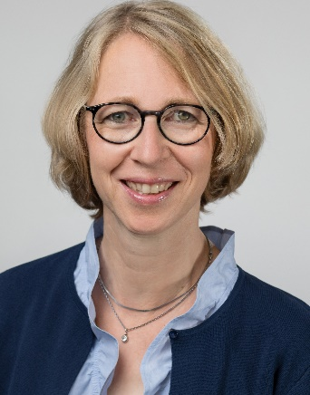
Your team at the OE-A
Dr. Klaus Hecker
Managing Director
+49 (0) 69 66 03-13 36 klaus.hecker@oe-a.org
Isabella Treser
Press & Public Relations
+49 (0) 69 66 03-18 96 isabella.treser@oe-a.org
Raswanth Sendhil Sasikala Roadmap & Working Groups
+49 (0) 69 66 03-18 56 raswanth.sendhilsasikala@oe-a.org
Alice Persichetti Press & Public Relations +49 (0) 69 66 03-19 71 alice.persichetti@oe-a.org
Patricia Seizer
OE-A Meetings & Events
+49 (0) 69 66 03-11 61 patricia.seizer@oe-a.org
Karen Strauch
Member Services
+49 (0) 69 66 03-18 78 karen.strauch@oe-a.org

