Slide 1
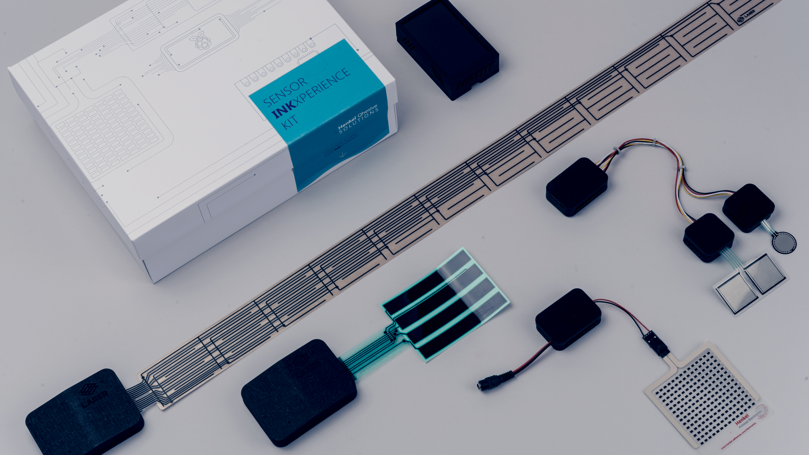
Printed Electronics for Smart Living or Smart Mobility
Student Open Innovation Challenge

Slide 2
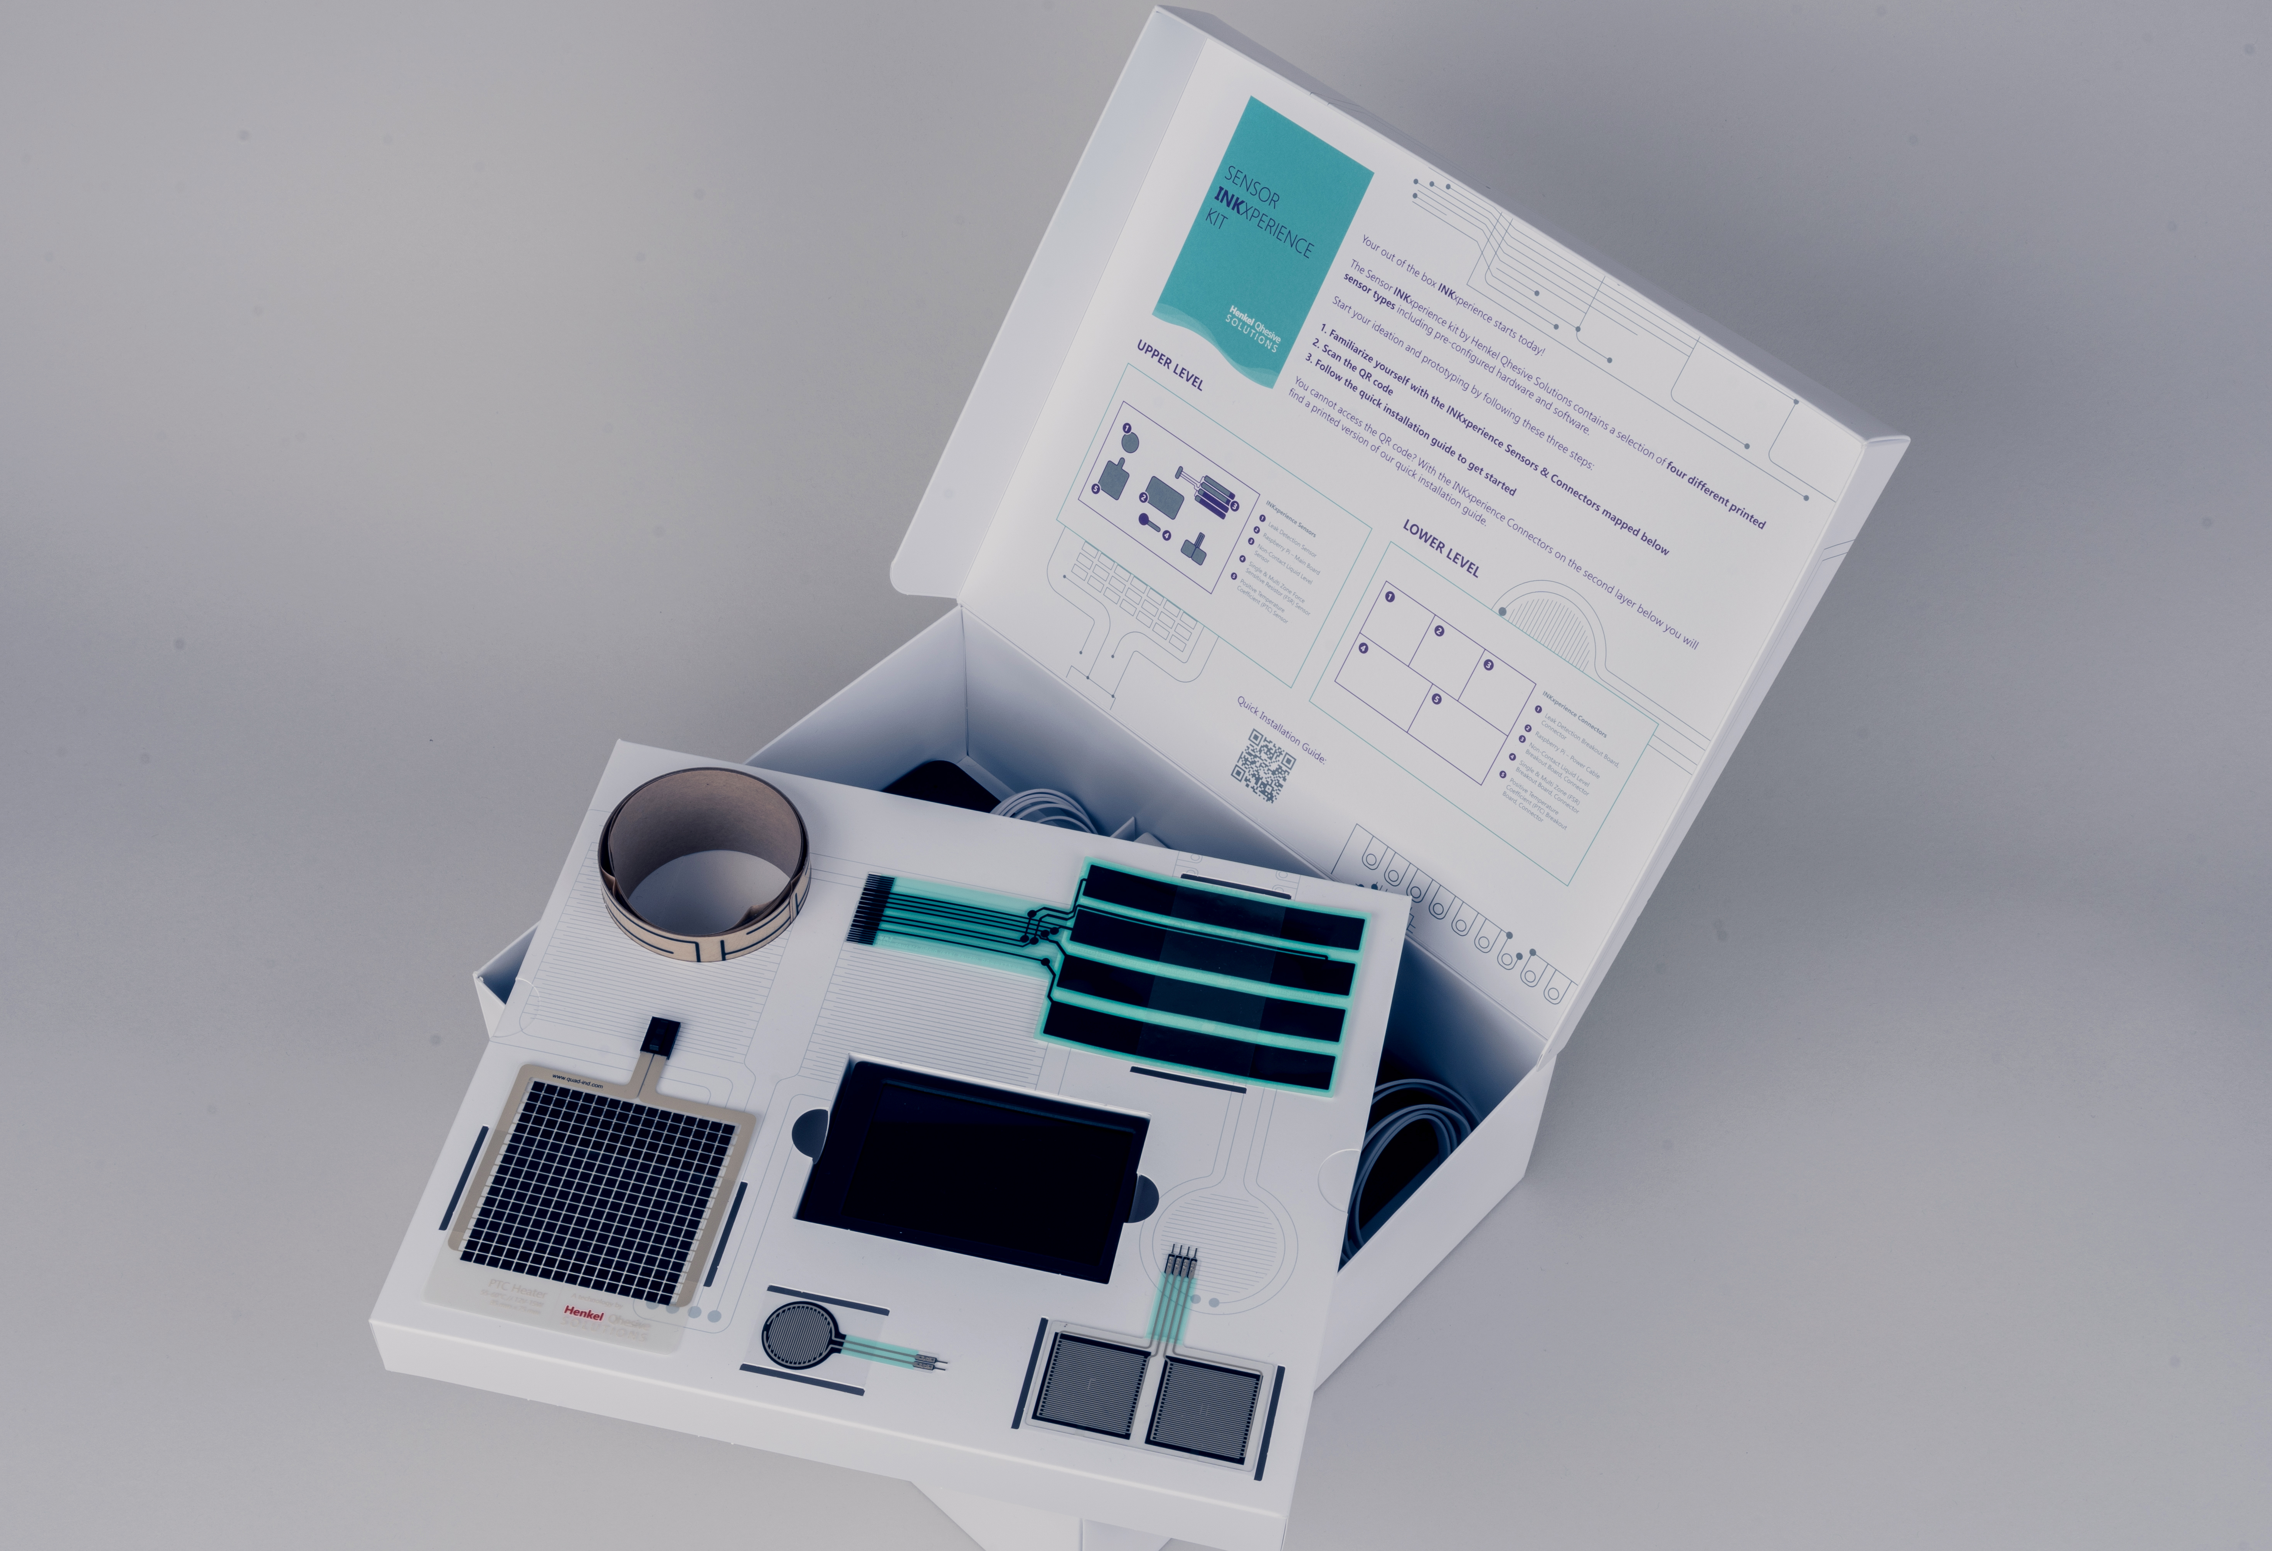
STUDENT OPEN INNOVATION CHALLENGE
Powered by the OE-A & HQS
WHAT
An open innovation challenge for university students on smart living or smart mobility, using the Henkel Qhesive Solutions Sensor INKxperience Kit.
THE CHALLENGE
Develop and prototype an innovative idea for a printed electronics application solving a problem in the market of smart living/mobility.
Deliver a miniature prototype of the solution and transfer the raw data output into a visually appealing dashboard showcasing the final information & data read out of your application.
THE PRIZE
The winning idea will be showcased at LOPEC 2024 at the OE-A booth.
Entrance tickets for the winning team members for LOPEC 2024 and will be awarded during the LOPEC Award Show.
Winner Team will present their demo at the OE-A Competition Web-Seminar in April 2024
©HENKEL QHESIVE SOLUTIONS

Slide 3
STUDENT OPEN INNOVATION CHALLENGE
Powered by the OE-A & HQS
Winning Criteria
Innovation & Impact: Identify a real challenge in the market of Smart Living or Smart Mobility and think of a proposal that will have an impact (social, environmental, etc…)
Printed Electronics: the Henkel INKxperience Kit includes different Printed Electronics technologies. How to better mix them to come to a more complete solution?
Data Value: we are in a data-driven age! The sensors will provide you raw data. How can we derive meaningful data from raw data values?
©HENKEL QHESIVE SOLUTIONS

Slide 4
STUDENT OPEN INNOVATION CHALLENGE
… AND THIS IS HOW IT WORKS
LOPEC 2024
6th – 7th March
16th Oct – 17th Nov 2023:
Submission phase for registration.
11th Dec 2023 – 31st Jan 2024
Henkel INKxperience Kits will be shipped to the selected teams. Teams will have until the 31st Jan work on their prototype.
13th Feb 2024
Virtual pitch of the teams presenting their prototypes.
01 Dec 2023
Teams’ selection will be made and groups will be notified.
31st Jan 2024
Prototypes should arrive to Henkel in Düsseldorf by this date.
14th Feb 2024
Winning team will be notified.
Key facts
5 teams will be selected for the challenge.
Winning team member will receive entrance tickets for LOPEC 2024 and will receive an award during the LOPEC Dinner & Award Show. Travel and accommodation costs not included.
Winning team present their prototype idea on the OE-A Competition Web-Seminar in April 2024
©HENKEL QHESIVE SOLUTIONS

Slide 5
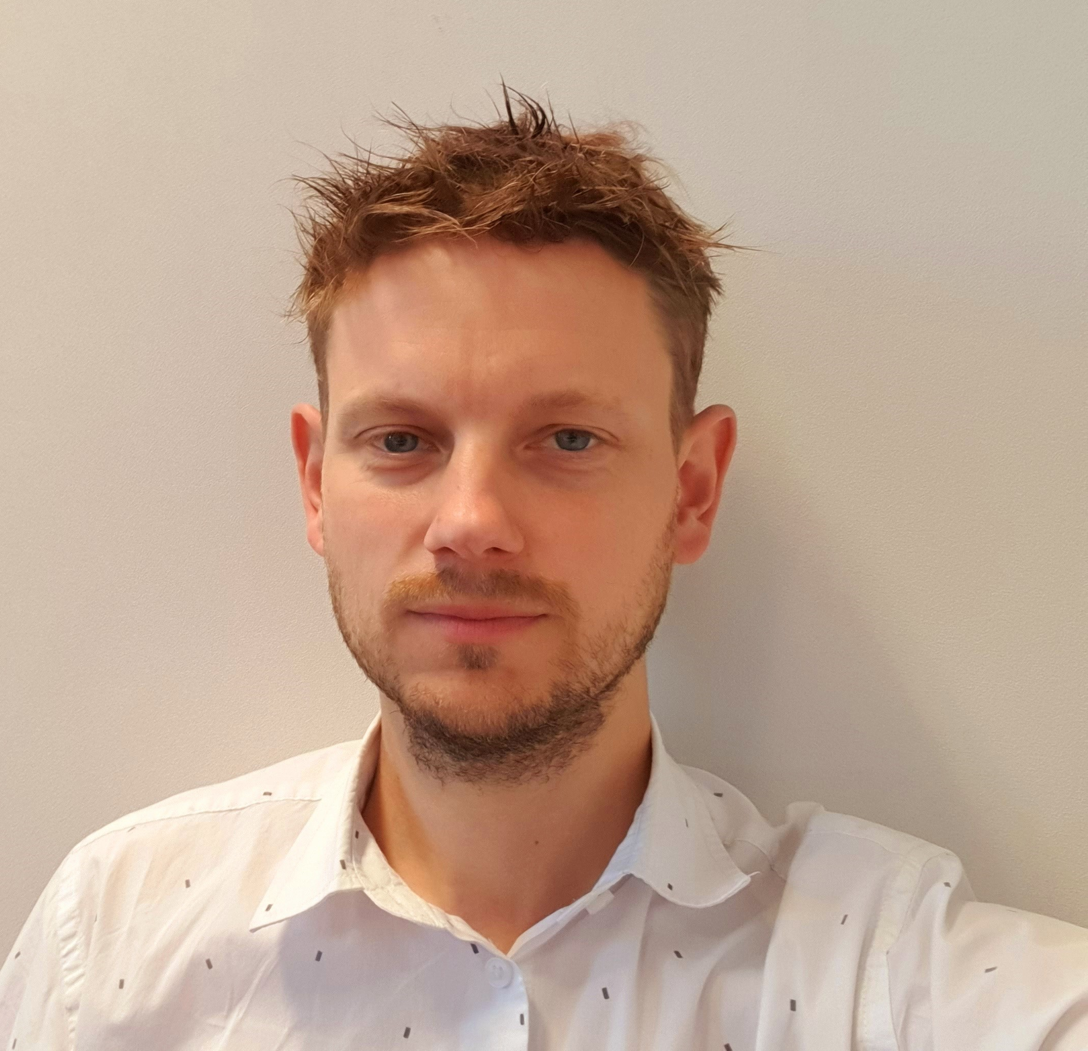
STUDENT OPEN INNOVATION CHALLENGE
The Jury
Juanita Rueda
Henkel, DE
Jenna Koenneke
Henkel, DE
Wim Christiaens
Quad Industries, NL
Dr. Klaus Hecker OE-A, DE
Dean Hotvet
Xymox Technologies, USA

Slide 6
OPEN INNOVATION CHALLENGE PRINTED ELECTRONICS FOR SMART LIVING/MOBILITY
Teams Application Form
Team Name:
University:
Country:
Address:
Leading Email address:
Team members:

Slide 7
OPEN INNOVATION CHALLENGE PRINTED ELECTRONICS FOR SMART LIVING/MOBILITY
Teams Application Form
Which challenge do you identify in the smart living/ smart mobility market?
Please provide a complete overview of the challenge you identified
Support your idea with market reports/technical papers/etc information
Describe why current solutions (if any) are not yet enough to solve the problem and why would it be important to think of a better solution.
Please use max 2 slides for this point

Slide 8
OPEN INNOVATION CHALLENGE PRINTED ELECTRONICS FOR SMART LIVING/MOBILITY
Teams Application Form
Which sensor(s) would you consider to use to prototype an idea that helps to solve this challenge?
Please provide a general description of your idea. How would you solve the previous described challenge? How would you intent to implement the different sensors (not all sensors NEED to be used, but the more complete the solution is, the better).
Please use max 1 slides for this point

Slide 9
OPEN INNOVATION CHALLENGE PRINTED ELECTRONICS FOR SMART LIVING/MOBILITY
Teams Application Form
Why and how does your idea bring added-value to the identified challenge?
Please submit a rough sketch of your concept (either a hand- or technical drawing)
Please use max 1 slides for this point

