Slide 1
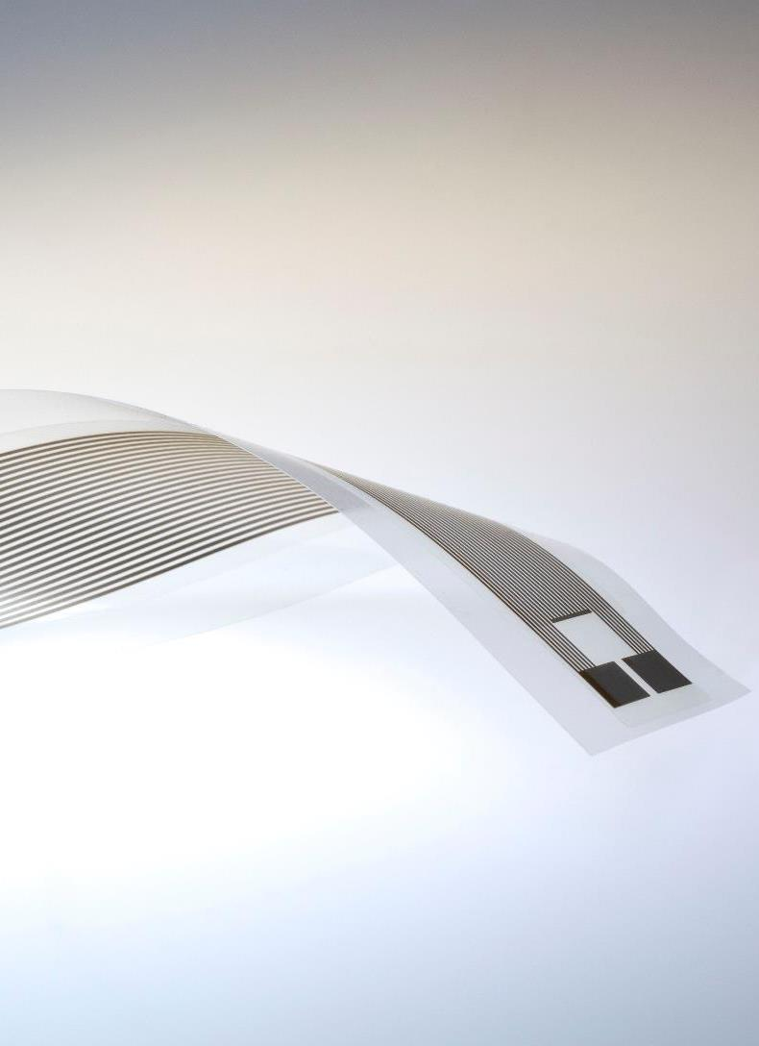

Introduction to the OE-A
Organic and Printed Electronics Association
Image source: Schreiner Group
OE-A
Frankfurt, Germany
www.oe-a.org
info@oe-a.org
A working group within

Slide 2
Printed Electronics in Everyday Life
Image source: Messe München, American SemiconductorLG, Royole, Brewer Science, Holst Centre, PolyIC, Heliatek
OLED displays
Rollable TV
Sensors
BIPV
Smart packaging for pharma-ceuticals
NFC tags
OLED
tail-lights
White goods

Slide 3

OE-A - Overview
Global non-profit industry association for organic and printed electronics, driven by over 200 international members
OE-A is a working group within VDMA
Our members represent the entire value chain:
  End-users
  Producers & system integrators
  Equipment & tool suppliers
  Component & material suppliers
  R&D institutes & universities
Image source: ojoimages4, Fotolia

Slide 4

Vision:
Flexible, organic and printed electronics are widely implemented for the benefit and value of society and industry
Image source: Unsplash
Vision
November 16, 2020

Slide 5

Mission:
OE-A facilitates an international network, fosters and advocates the flexible, organic and printed electronics community, and seeks cooperation with other markets and technical communities
Image source: Unsplash
Mission

Slide 6

Benefits of OE-A Membership
Networking, Information, Visibility & Market Entry Opportunities
  Networking Opportunities
  Web-Seminars
  Frequent Working Group Meetings
    Europe
    North America
    Asia
  LOPEC
  Industry Roadmaps
  Demonstrator Projects
  Industry Visibility
  Advocacy
  Products & Services Directory
  Free subscription to
  OPE Journal
  Biannual Business Climate Survey
  Participation in international exhibitions / joint pavillions
  Discounts on event tickets
Image source: Unsplash
oe-a.org/member-benefits

Slide 7
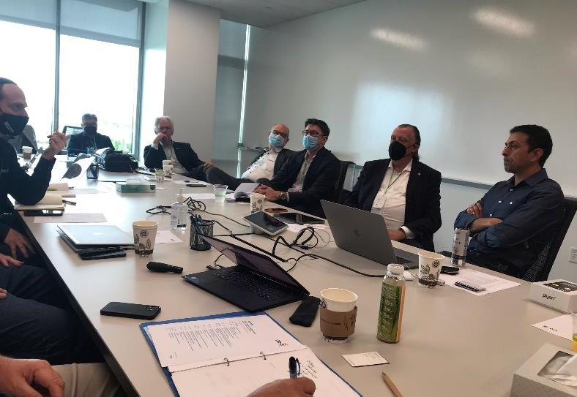
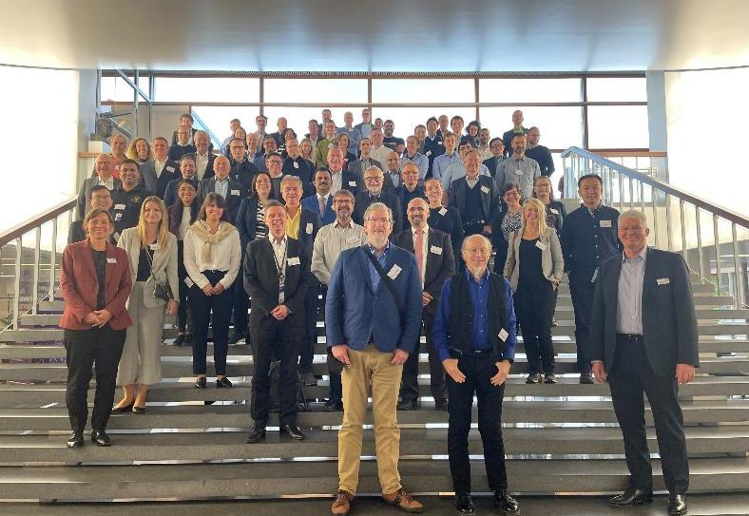
Working Groups
Roadmap
OE-A Competition
Hybrid Systems
Sustainability
Encapsulation
Education
Women in PE
Marketing
Image source: OE-A
November 16, 2020

Slide 8








Event Schedule 2023
Europe / Asia / North America
  OE-A Meeting, February 27, 2023, Munich (DE)
  LOPEC 2023, February 28 March 2, 2023, Munich (DE)
  OE-A Student Workshop on Printed Batteries, February 28 2023, Munich (DE)
  ICDT 2023, March 31 - April 3, 2023, Nanjing (CN), hosted by SID China
  OE-A Web-Seminar Printed Electronics Insights: OE-A Competition 2023 - The Winners, April 19 2023, online
  OE-A Meeting North America, May 3-4 2023, Boston (US), hosted by E-Ink, MIT
  Web-Seminar Update on Status ESPR (Eco-Design for Sustainable Products Regulation), May 25 2023, online
  OE-A Meeting Europe, September 19-20 2023, Echternach (LUX), hosted by IEE
  ICFPE 2023, October 2023, date and venue tbd
  OE-A Meeting Asia, October 2023, date and venue tbd
  productronica 2023, November 14-17, 2023, Munich (DE)
  oe-a.org/events

Slide 9
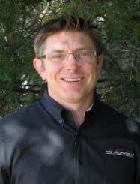
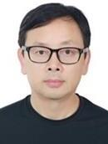
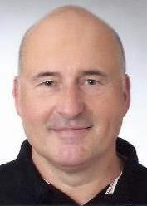
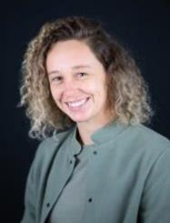












OE-A Board of Directors
Chair
Stan Farnsworth
Vice Chair Asia
Dr. Xiaolin Yan
Vice Chair Europe
Dr. Alain Schumacher
Vice Chair North America
Dr. Chloé Bois
Members of the Board
Chuck Milligan
Dr. Georg Bernatz
Corinne Versini
Prof. Jukka Hast
Thomas Kolbusch
Dr. Guido van Tartwijk
Dr. Jérôme Gavillet
Dr. Ton van Mol
Prof. Ulrich Moosheimer

Slide 10


































































































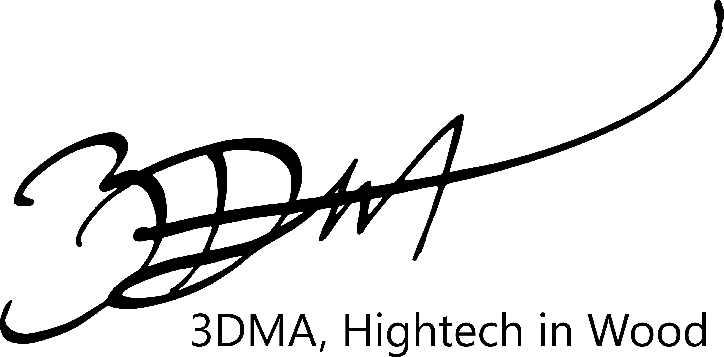






200+ Members
Representing the entire value chain (1)
Companies
Equipment
Devices
Materials
End-User

Slide 11
















































200+ Members
Representing the entire value chain (2)
Research Institutes

Slide 12

Global membership base
Europe
172
OE-A is active in
  Europe
  North America
  Asia
  Africa
VDMA / OE-A Headquarters
  Frankfurt, Germany
VDMA Representations
  Berlin, Brussels, Austria, BeNeLux, Italy, US,
  Japan, China, India, Brasil, Iran
North
America
21
DE 75
FR 19
GB 16
CH 8
FI 8
ES 7
NL 7
IT 6
AT 5
CZ 4
PT 3
GR 2
BE 2
PL 2
LU 2
SE 2
NO 1 RS 1
DK 1
IE 1
Asia
19
JP 6
CN 5
TW 2
KR 2
AE 1
IL 1
IN 1
TR 1
US 18
CA 3
Africa
ZA 1
Total: 213 Members (as of February 1, 2023)
  oe-a.org/oe-a-members

Slide 13
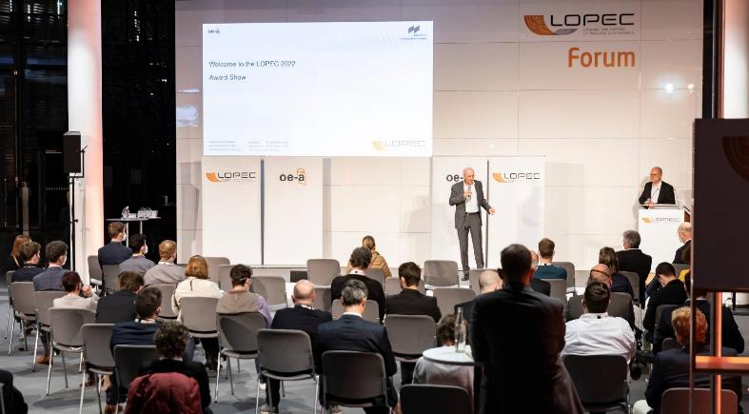
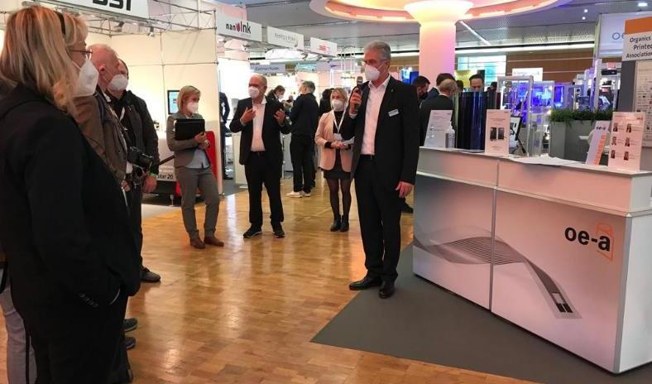

LOPEC 2024
March 5-7
ICM, Messe Munich
The central marketplace for Organic and Printed Electronics, in cooperation with Messe Munich
  2,500+ attendees
  150+ international exhibitors
  180+ presentations
Exhibition
  Largest industry exhibition in the field
  Start-up forum
Conference
  Business, Technical, Scientific Conference
  Pre-conference seminars
  Call for Papers open Sept 7 – 29, 2023
10% discount for OE-A members
Image source: Messe München
www.lopec.com
| info@oe-a.org

Slide 14

OE-A within VDMA
Benefit from being part of something bigger
Largest industry association in Europe
(>3,600 members)
  36 trade associations - Experts for product-specific topics
  11 specialized departments - Consultation in all specific topics
  6 regional subsidiaries in Germany
  Offices in Brussels and Berlin - Exchange with political decision makers and key stakeholders
  Foreign subsidiaries in Brazil, China, India, Iran, Japan, Russia and Austria - On-site consultation and support
  Working groups and forums - Cross-sectoral cooperation
  Service companies
  (trade fair organizer, publishing house, insurance company etc.)
Image source: Hans-Peter Gauster / Unsplash
www.vdma.org

Slide 15
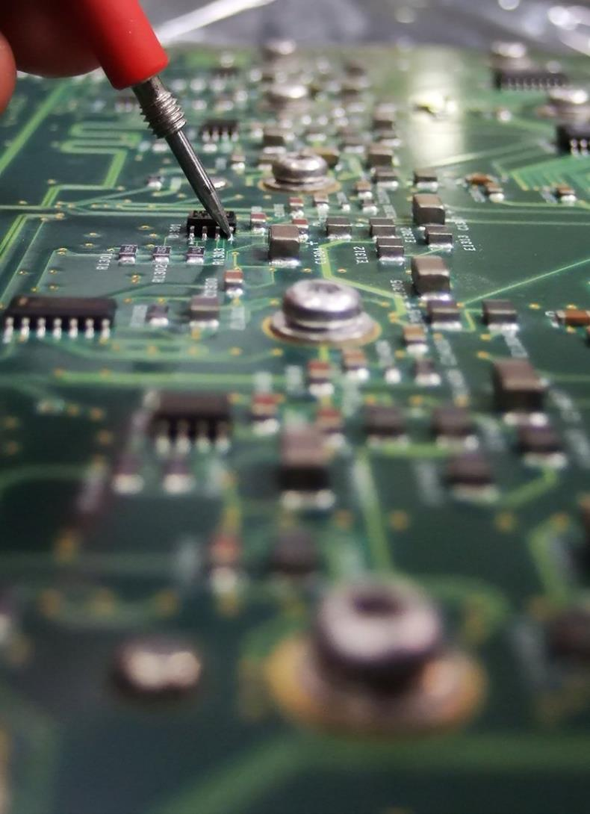
OE-A within VDMA: EMINT
OE-A is an associated group within VDMA EMINT (Electronics, Micro and New Energy Production Technologies)
  Four sector groups:
      Productronic
      Micro Technologies
      Battery production
      Photovoltaic-Production Equipment (PV)
  Associated Group:
  OE-A
  Joint activities:
    OE-A Working Group Hybrid Systems
    productronica
Image source: freeimages.com/Bart Hickman

Slide 16
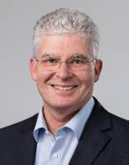
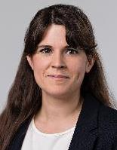
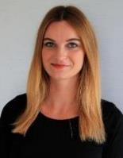
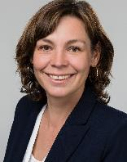
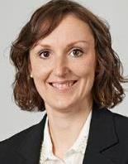
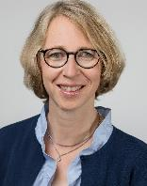
Your team at the OE-A
Dr. Klaus Hecker
Managing Director
+49 (0)69 66 03-13 36
klaus.hecker@oe-a.org
María Espinosa Poma
Trade Shows & Web-Seminars
Team Assistant
+49 (0) 69 66 03-17 37
maria.espinosapoma@oe-a.org
Theresa Manns
Press & Public Relations
Assistant
+49 (0)69 66 03-11 94
theresa.manns@oe-a.org
Isabella Treser
Press & Public Relations
+49 (0)69 66 03-18 96
isabella.treser@oe-a.org
Daria Knoth
OE-A Meetings & Conferences
Assistant
+49 (0) 69 66 03-18 81
daria.knoth@oe-a.org
Karen Strauch
Member Services
Assistant
+49 (0)69 66 03-18 78
karen.strauch@oe-a.org

